Slide 1


Data Mining With Deep Learning
Jiban-Ul Azam Chowdhury Shafin
Submitted To:
Achim Rettberg
Charles Steinmetz
Narmada Ambigapathy

Slide 2
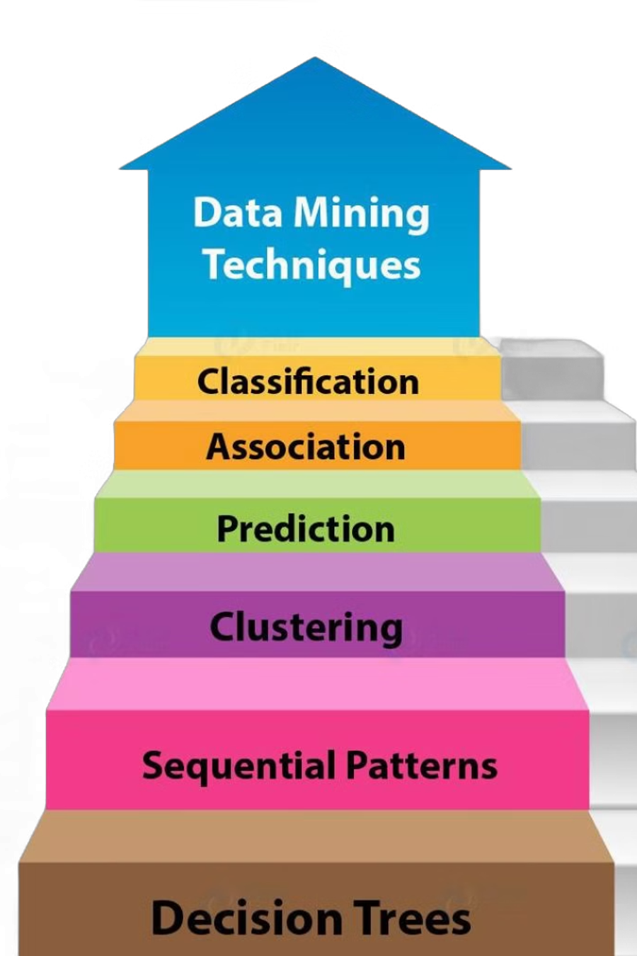
Data Mining
Data mining is the process of discovering patterns and insights from large datasets. It involves several key stages, including data collection, preprocessing, and transformation. Core techniques include classification, clustering, association rule mining, and anomaly detection.
1
Data Collection and Preparation
Gathering data from diverse sources and ensuring consistency
2
Data Cleaning and Preprocessing
Removing noise, handling missing values, and resolving inconsistencies
3
Data Transformation
Converting raw data into suitable formats and deriving meaningful features
4
Pattern Discovery and Analysis
Applying various techniques to uncover hidden insights

Slide 3

Deep Learning
Deep learning is a subset of machine learning that uses neural networks with multiple layers. These networks can automatically learn hierarchical representations from raw data, making them powerful tools for complex pattern recognition tasks.
Neural Network Structure
Popular Models
Composed of input, hidden, and output layers connected by weighted edges
CNNs: Convolutional Neural Networks
RNNs: Recurrent Neural Networks
GANs: Generative Adversarial Networks
Autoencoders
Hyperparameter Tuning
neural network that encode and decode data identifying patterns and anomalies
Optimizing learning rate, batch size, and network architecture for best performance

Slide 4
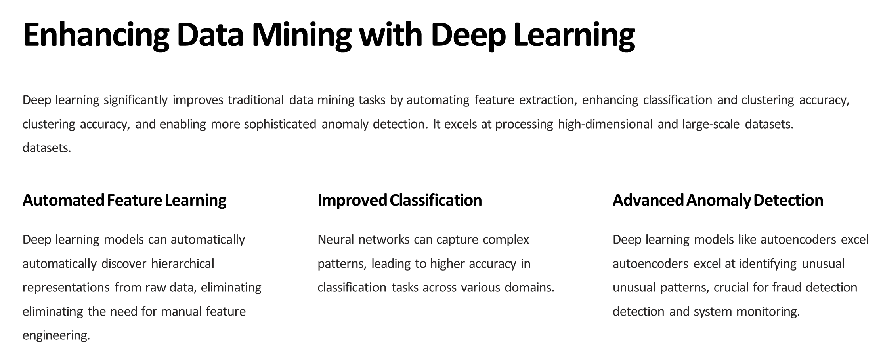

Slide 5
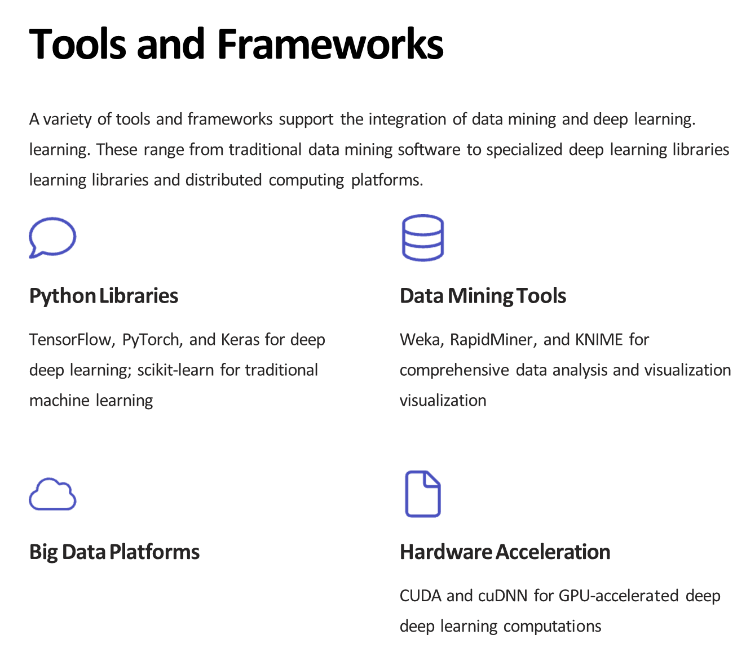

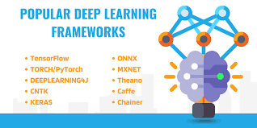
Apache Spark and Hadoop for distributed processing of large-scale datasets

Slide 6
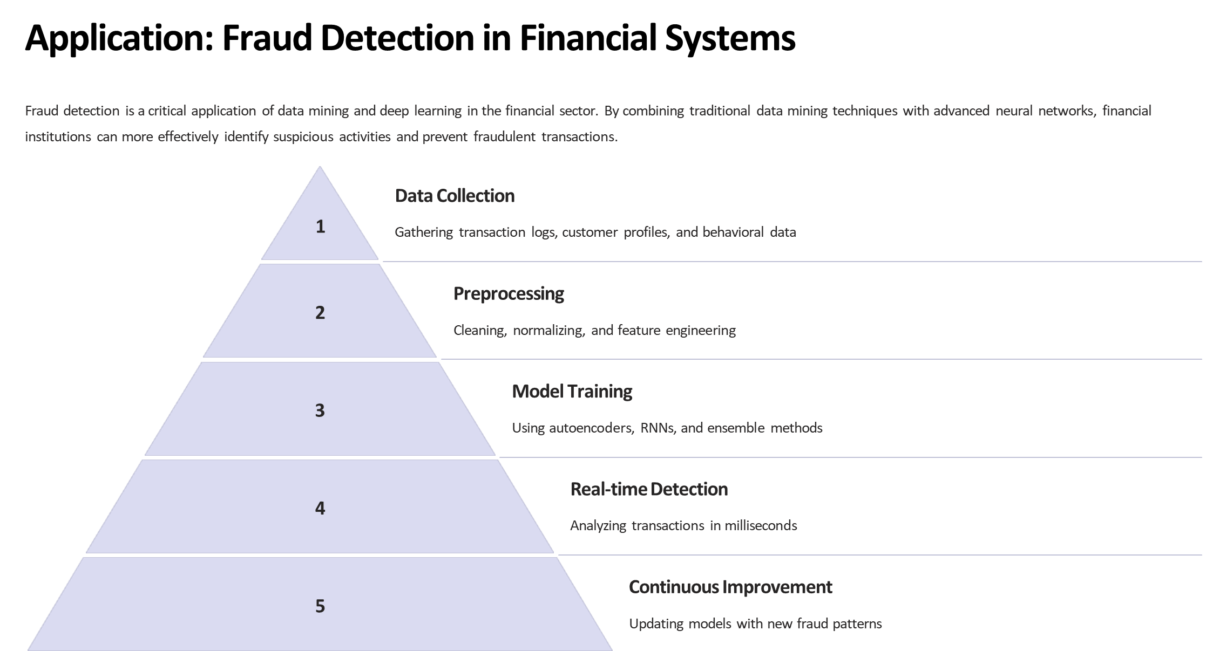

Slide 7
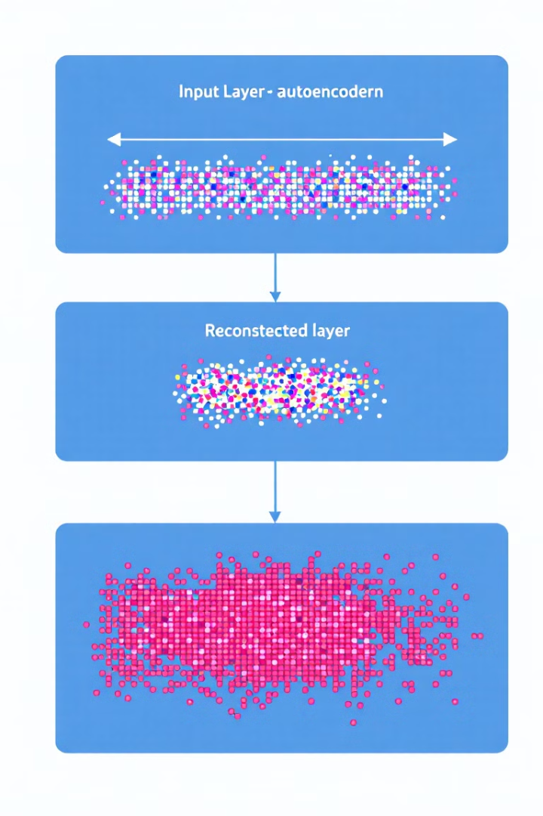




Implementation Example: Autoencoder for Fraud Detection
An autoencoder-based deep learning model was implemented for credit card fraud detection. The model was trained on normal transactions to learn legitimate patterns and then used to identify anomalies based on reconstruction error.
Data Preprocessing
Normalizing transaction amounts and splitting into training/testing sets
Model Architecture
Autoencoder with encoder and decoder layers
Training
50 epochs, batch size of 64, using Adam optimizer
Fraud Detection
Using reconstruction error threshold

Slide 8

About Dataset
Credit Card Fraud Detection
Anonymized credit card transactions labeled as fraudulent or genuine
Content
The dataset contains transactions made by credit cards in September 2013 by European cardholders. This dataset presents transactions that occurred in two days, where we have 492 frauds out of 284,807 transactions.
The dataset is highly unbalanced, the positive class (frauds) account for 0.172% of all transactions.
Powered by

Slide 9
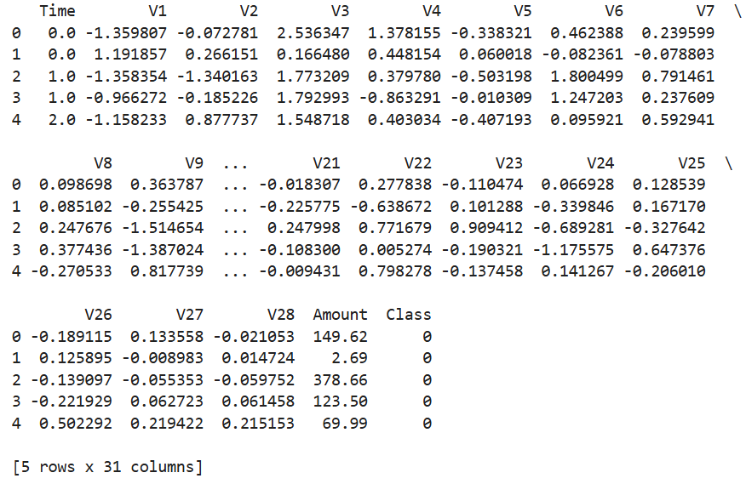
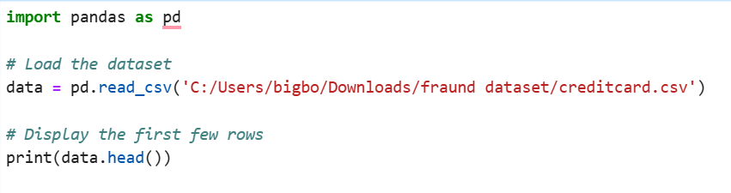
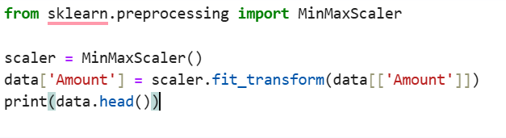
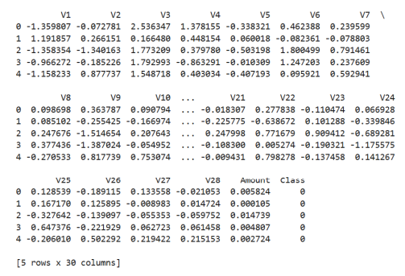
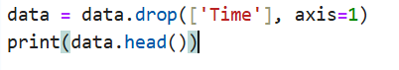
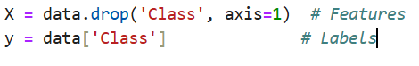
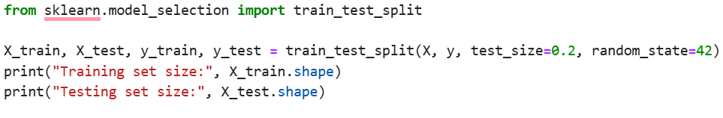

Slide 10
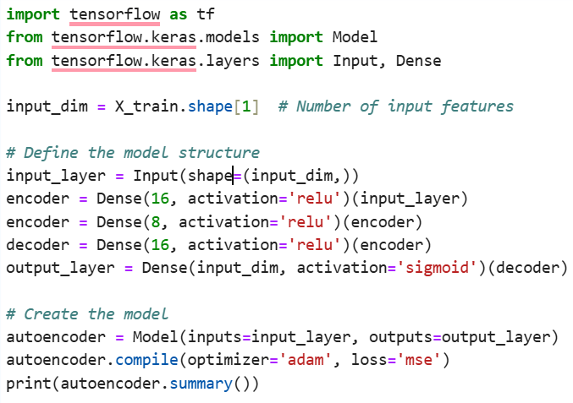
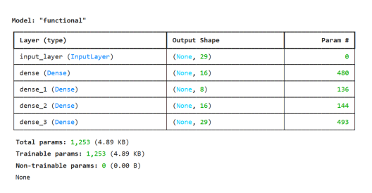

Slide 11
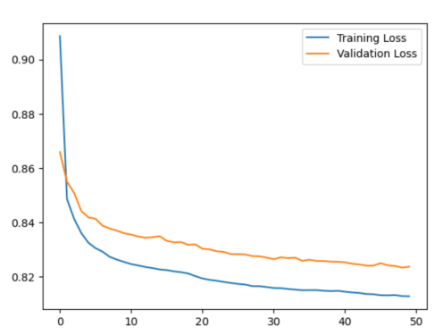
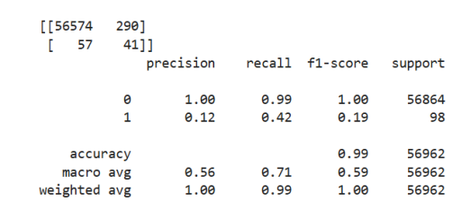
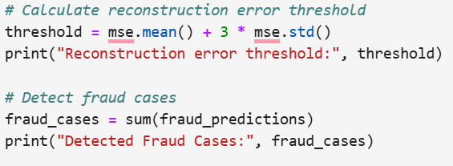
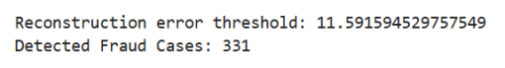

Slide 12

Future Trends and Conclusion
The integration of data mining and deep learning continues to evolve, opening new possibilities while also presenting challenges. Future trends include applications in autonomous systems, knowledge graph mining, and quantum computing for data processing.
Ethical Concerns
Generalizability
Addressing bias, transparency, and fairness in models
Improving model adaptation to new data domains
Privacy and Security
Computational Demands
Ensuring data protection in increasingly pervasive systems
Meeting the increasing need for processing power and efficiency

Slide 13
Thanks for the attention

